Slide 1
Consumer Costs of Water Shortage:
Overview and Empirical Evidence
Presentation to the Water Supply Advisory Committee
David Mitchell, M.Cubed
February 11, 2015

Slide 2
What is Meant by “Supply Reliability”?
Full-Service Demand
Demand without mandatory rationing or other short-term restrictions, but reflective of Demand-Reducing Measures
Demand-Reducing Measure
Any long-term measure intended to reduce consumer demand for potable or non-potable water
Available Supply
Total volume of water expected to be available in a particular period for uses from statewide, regional, or local sources
Water Supply Reliability
The degree to which water consumers receive their Full-Service Demand, after accounting for Demand Reducing Measures, within acceptable quality and service standards
Source: California Urban Water Agencies (1992) “Water Supply Reliability in California, Phase 1 Report”

Slide 3
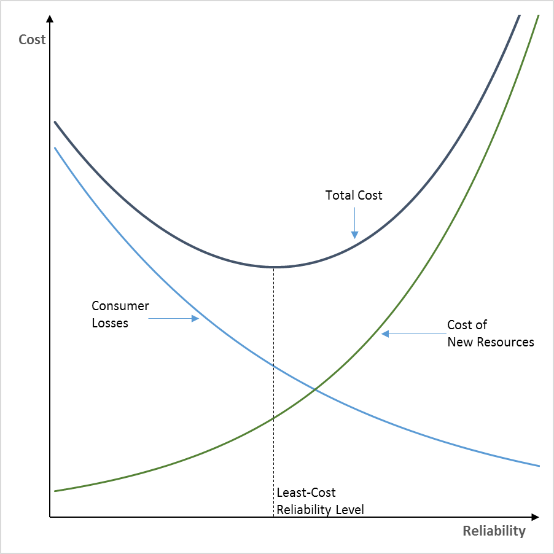
Supply Reliability Sweet Spot
Resource costs increase with reliability
Consumer losses decrease with reliability
Total Cost = Resource Cost + Consumer Loss
Reliability planning involves balancing consumer loss from shortages against the cost of improving system reliability
Today’s focus

Slide 4
Translating Water Supply Shortages into Reductions in Economic Welfare
Change in
Actual
Water Use
Drought
Management
Policies
Education
Users
Residential
Commercial
Industrial
Water
Supply
Shortages
Pricing
Restrictions
Change in
Economic
Welfare
Appeals
Source: Dixon, L., et al., “Drought Management Policies and Economic Effects in Urban Areas of California, 1987-1992. RAND.

Slide 5
Typical Shortage-Induced Changes in Economic Welfare
Residential Impacts
Business Impacts*
Constrained behavior (hassle factor, e.g. shorter showers, irrigation restrictions)
Quality of Life (brown landscapes, impaired parks and play fields, dirty cars, windows, hard surfaces)
Higher water cost (income reduction)
Increased household expense (conservation costs, destroyed landscaping)
Reduced profit (output restrictions, increased production cost, lower demand)
Reduced wage income
Reduced employment
Loss of market share
* Not all impacts will be negative. Some businesses may experience increased demand during shortages – e.g. businesses selling conservation devices or services.

Slide 6
Empirical Estimates of Urban Shortage Costs

Slide 7
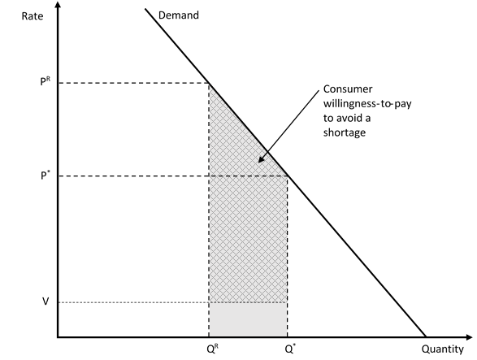
How Are Losses Measured?
Shortage costs are measured by calculating consumer willingness to pay to avoid water service interruptions.
We use the economic theory of demand to calculate willingness to pay (WTP), as shown by the figure.

Slide 8
Empirical Methods of Measurement
Two ways to measure WTP
Econometrically estimate demand curves and use to calculate WTP
Directly (but cleverly) ask households and businesses their WTP to avoid shortages. This is called Contingent Valuation
Both are challenging to implement. Both entail measurement uncertainty.

Slide 9
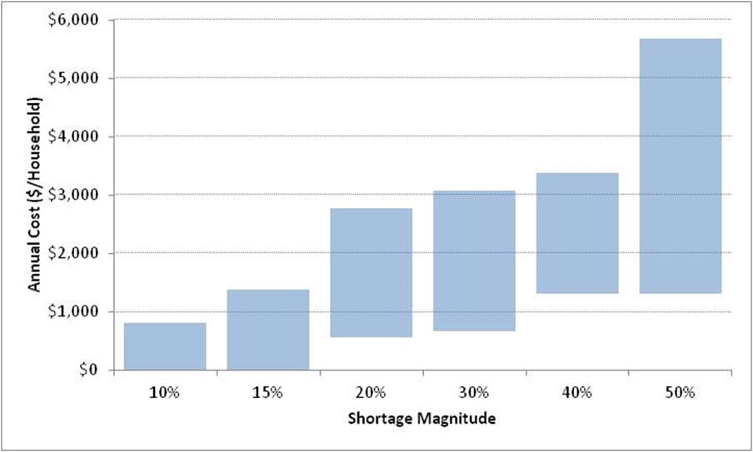
Residential Annual Shortage Cost Ranges based on 4 Empirical Studies
Howe, C. W., & Smith, M. G. (1994). The Value of Water Supply Reliability in Urban Water Systems. Journal of Environmental Economics and Management, 26, 19-30.
Barakat & Chamberlin, Inc. (1994). The Value of Water Supply Reliability: Results of a Contingent Valuation Survey of Residential Customers. Sacramento: California Urban Water Agencies.
Griffin, R. C., & Mjelde, J. W. (2000). Valuing Water Supply Reliability. American Journal of Agricultural Economics, 82, 414–426.
Hensher, D., Shore, N., & Train, K. (2006). Water Supply Security and Willingness to Pay to Avoid Drought Restrictions. The Economic Record, 82(256), 56-66.

Slide 10
RAND study of 1987-1992 Drought
Average water costs increased for all customer classes. Comparable water cost impacts for residential and business customers.
Largest impacts in residential sector -- $40 to $60 million (2012 dollars) in Bay Area during summer of 1991.
Drought policies mostly shielded commercial and industrial users, but some sectors – notably green industry – were significantly impacted.

Slide 11
Foster Associates (1994) Study of Water Shortage Impacts on California’s Green Industry
4,500 green industry jobs and $129 million in wages and salaries (2012 dollars) directly lost due to water shortages in 1991.
Recession was a confounding factor – study estimated recession directly accounted for loss of an additional 4,000 green industry jobs and $100 million in wages and salaries.
A further 13,500 jobs and $382 million in wages and salaries were lost through a combination of causes.
Water shortages identified as the primary cause of 18% of total green industry job loss and 21% of total output loss.

Slide 12
Wade, W. et al. (1991) Cost of Industrial Water Shortages
Surveyed industry responses to hypothetical 30% one-year shortage
$19.6 billion reduction in output (based on 1990 value of shipments)
Biggest impacts occur in four industries: (1) refining, (2) high tech, (3) beverages, and (4) food processing
Direct employment losses of 46,000 jobs
Industrial impacts concentrated in Southern California

Slide 13
2007 Bay Area Economic Forum Study of Potential Bay Area Water Shortage Impacts
Employment
Impacts
Consumer Surplus Impacts
(residential + commercial)
Shortage % | Payroll Losses (%)
 | Industrial | Commercial
10% | 0.8-1.1% | 0.1%
20% | 1.6-2.0% | 0.2%
30% | 4.9-6.8% | 3.0-6.0%
Shortage % | Consumer Surplus Loss (million 2012 dollars)
10% | $17 - $34
20% | $56 - $107
30% | $119 - $219

Slide 14
Macro Economic Impacts of Australia’s “Big Dry”
Decimated agricultural export industry – rice exports reduced by 90%
In agricultural regions household consumption fell by 5-11%, gross regional product by up to 11%, and employment by up to 21%
In 2002-03, nationwide the drought shaved 1.6% off GDP growth, 0.8% off employment growth, and 0.9% off wage growth. Exports fell by 5%.
40% of the reduction in GDP growth associated with non-agricultural industries.
Wholesale electricity costs doubled in 2007 due to loss of hydropower
More than $4.4 billion (U.S. dollars) in drought economic assistance provided to distressed communities and businesses.
By end of 2012, Australia had constructed 343 MGD of seawater desalination capacity at a total construction cost of $10.4 billion (U.S. dollars)

Slide 15
California Businesses Getting Nervous About Water

Slide 16
What Business Leaders are Saying
"…companies and investors can no longer take water for granted,"
Anne Stausboll, chief executive of the California Public Employees' Retirement System, the largest U.S. public pension fund, with approximately $220 billion in assets. “Water Scarcity: Hidden Risks to Business,” Bloomberg BusinessWeek, February 26, 2009.
“…if you are constantly going through a cycle of not knowing whether you are going to have water, which is an essential resource for these companies, at some point you may want to look at other venues where it’s not going to be a question.”
Jimmy Jackson, vice president of public policy and communications at Biocom, a trade association that represents more than 560 members in the life sciences industry in San Diego
More than 820 life science companies are located in the San Francisco Bay Area, including the East Bay, Silicon Valley, and South San Francisco, employing a workforce of 250,000

Slide 17
Hospitality Sector
“Water is very important you can't have a hotel without water.”
Ron Caldwell, of Le Meridien/ San Francisco
“Water is a critical component to our operations—we need water for everything from meal preparation and cooling tower operation to laundry and landscaping … We are concerned about water reliability … We have sincere concerns about future supplies of fresh water.”
Marianne Balfe, director of energy and environmental sustainability, Marriott International, Americas
“Not only are we supplying domestic water to 1,004 guest rooms, we also have four kitchens, three restaurants, a Starbucks, 10 public bathrooms, janitor closets, more than 40 ice machines, landscape irrigation. At all of these locations there is a need for properly tempered, clean fresh water.”
Glen Mounts, Los Angeles Airport Marriott

Slide 18
Santa Cruz County* At Risk Sectors
Sector | Establishments | Employment | Annual Payroll ($1,000)
Car Washes | 8 | ND | $1,755
Nursery, Garden Center | 18 | 148 | $4,214
Flower, Nursery Stock Wholesalers | 15 | 543 | $15,248
Accommodation | 89 | 1,412 | $34,977
Food Services and Drinking Places | 590 | 8,469 | $140,872
Amusement and Theme Parks | 1 | ND | ND
Golf Courses and Country Clubs | 6 | 214 | $4,744
Fitness and Recreational Centers | 37 | 654 | $8,150
Food Manufacturing | 40 | 1,287 | $54,192
Computer and Electronic Products | 39 | 571 | $39,726
* Data for all of Santa Cruz County
Source: 2012 County Business Patterns

Slide 19
Lessons from Santa Cruz Business Focus Groups, Fall 2014

Slide 20
Green Industry
Nurseries/Garden Centers
Sales down 13-20% because of water use restrictions
Drought of equal consequence as recession in terms of impact on sales
Water uncertainty impacting inventory costs and profitability
Landscape Contractors
Financial impact still uncertain
Spending much more time with frustrated/angry clients
Clients deciding to stop maintaining landscape until water situation improves
Golf Courses
Significant costs being incurred to replace turf, invest in irrigation
Significant drop in green fees ($500,000 to $1,000,000)
Reputation effects are a big concern. Business sustained primarily by word of mouth reviews of courses. Golfers have lots of choices to play elsewhere.

Slide 21
Hospitality Sector
Principal concern of sector: What else can we do? Most properties already fully retrofitted
Very worried that Stage 4 restrictions would impact both revenue and profitability
Rising water costs are starting to impact net revenue, particularly for restaurants
Boardwalk has retrofitted all fixtures, installed meters on all points of water use, installed recycling systems, and is looking at replacing remaining turf with artificial grass

Slide 22
Correlated Risks
Agriculture is most vulnerable to water shortages
Regional economies with strong linkages to agriculture, like Santa Cruz County’s, are doubly at risk if urban and agricultural water supply reliability is correlated – for example, if both depend on the same primary sources for water.
In these cases, impacts in both agricultural and urban sectors can compound region-wide impacts

Slide 23
Questions/Discussion

Slide 24
2002 Silicon Valley Manufacturing Group Survey
Two-thirds of surveyed companies said a thirty day interruption in water service would force them to shut down completely.
Many had no backup plans for the event of unexpected, severe rationing or complete water outages.
Similar interviews with commercial and industrial water users in the Bay Area indicate that businesses are concerned that drought-related water supply interruptions would have serious operational impacts on businesses.
Brozovic, N, Sunding, D., and Zilberman, D., “Estimating Business and Residential Water Supply Interruption Losses from Catastrophic Events, Water Resources Research (2007) Volume: 43, Issue: 8; and Bay Area Economic Forum. Hetch Hetchy water and the Bay Area economy, October 2002.

